Slide 1

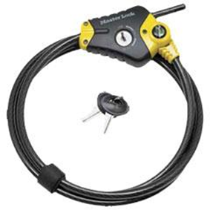
Basic locks.
Definition : A hinge is a moving joint
Different types of locks
1. Disc padlock
2. Cable lock

Slide 2
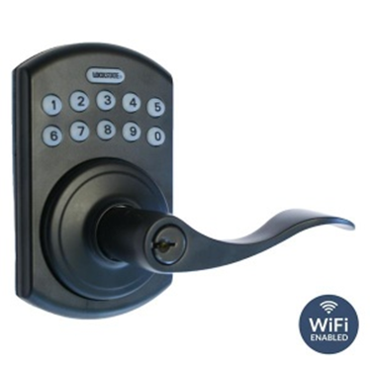
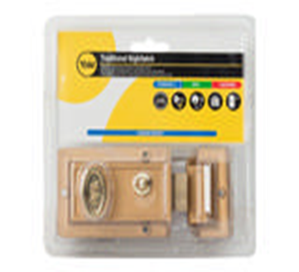
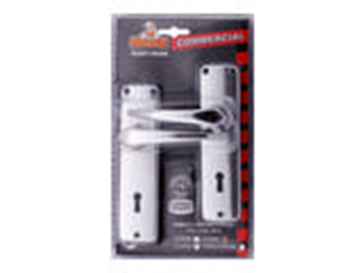
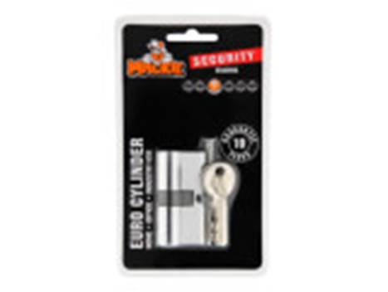
3. Remote lock
4. Night latch brass lock
5. Lever lockset
6. Cylinder lock

Slide 3
Adhesives
Definition : an adhesive substance used to stick objects or materials.
Different types of adhesive
- Superglue
- White glue or wood glue
- General construction glue
- Epoxies
- Craft glue
Demonstration Video
Locks Video –
Adhesive Video -
Feedback : Activity

Slide 4
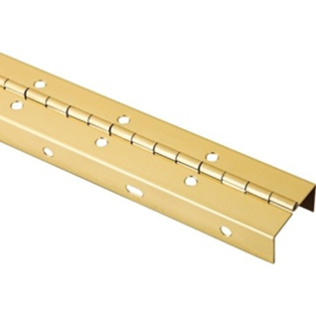
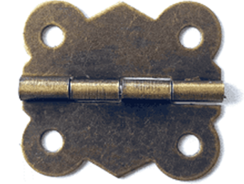
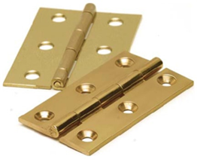
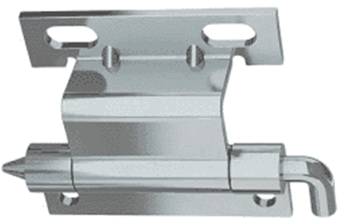
Kwa Thema Skills School
Subject : Maintenance Marks : 15
Grade : Year 2 Time : 30mins
Date :
Question:1
Name the following hinges.
1.__________________ 2.______________________
3.___________________ 4. ______________________

Slide 5
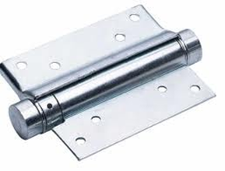
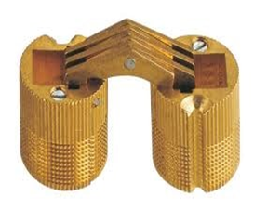
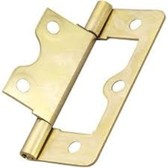
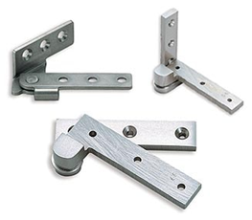
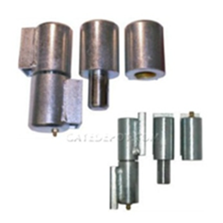
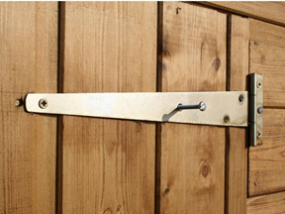
5. _________________ 6. ____________________
7. __________________ 8. ___________________
9. __________________ 10. ___________________
(10)

Slide 6
Question : 2
Name five types of adhesive
a. __________________
b. __________________
c. __________________
d. __________________
e. __________________
(5)

Slide 7

Feedback
Activity : Worksheet 8
Practical lesson or Project
Jewelry box

